Slide 1
Gaussian Mixture Model [GMM]
A Gaussian mixture model is a soft clustering technique used in unsupervised learning to determine the probability that a given data point belongs to a cluster.
It’s composed of several Gaussians, each identified by k ∈ {1,…, K}, where K is the number of clusters in a data set.
Each Gaussian k in the mixture is comprised of the following parameters
A mean μ that defines its center.
A covariance Σ that defines its width. This would be equivalent to the dimensions of an ellipsoid in a multivariate scenario.
A mixing probability π that defines how big or small the Gaussian function will be.

Slide 2
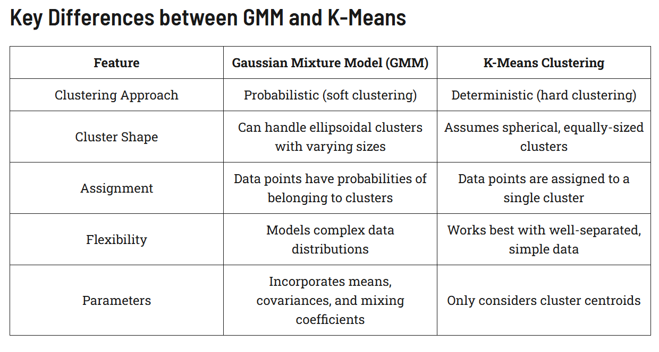

Slide 3
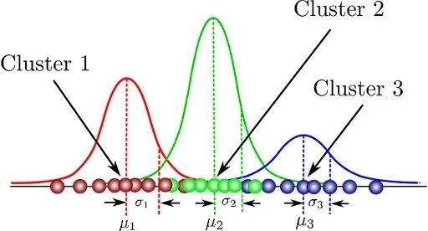
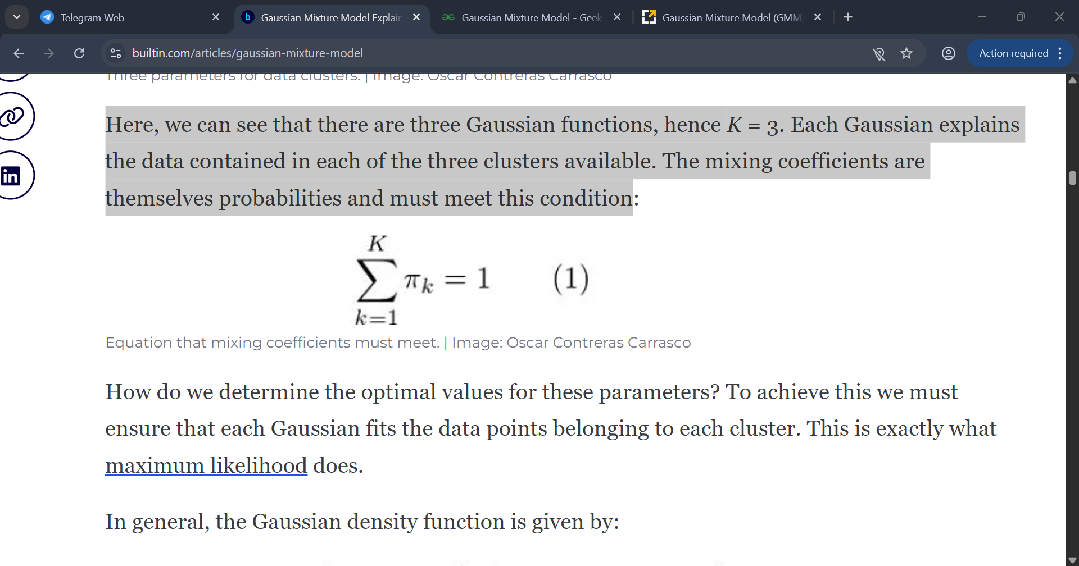
Here, we can see that there are three Gaussian functions, hence K = 3.
Each Gaussian explains the data contained in each of the three clusters available. The mixing coefficients are themselves probabilities and must meet this condition

Slide 4
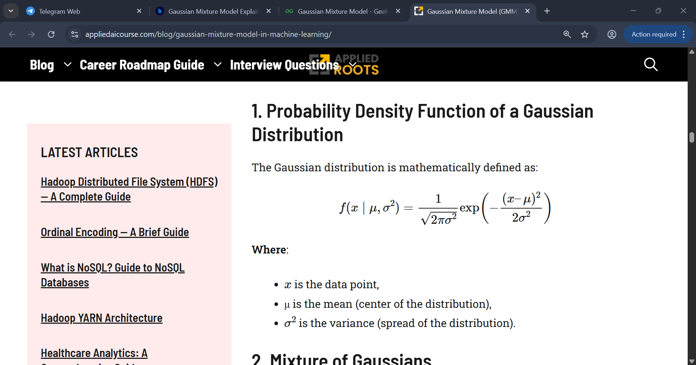
Probability Density Function of a Gaussian Distribution
The Gaussian distribution is mathematically defined as

Slide 5
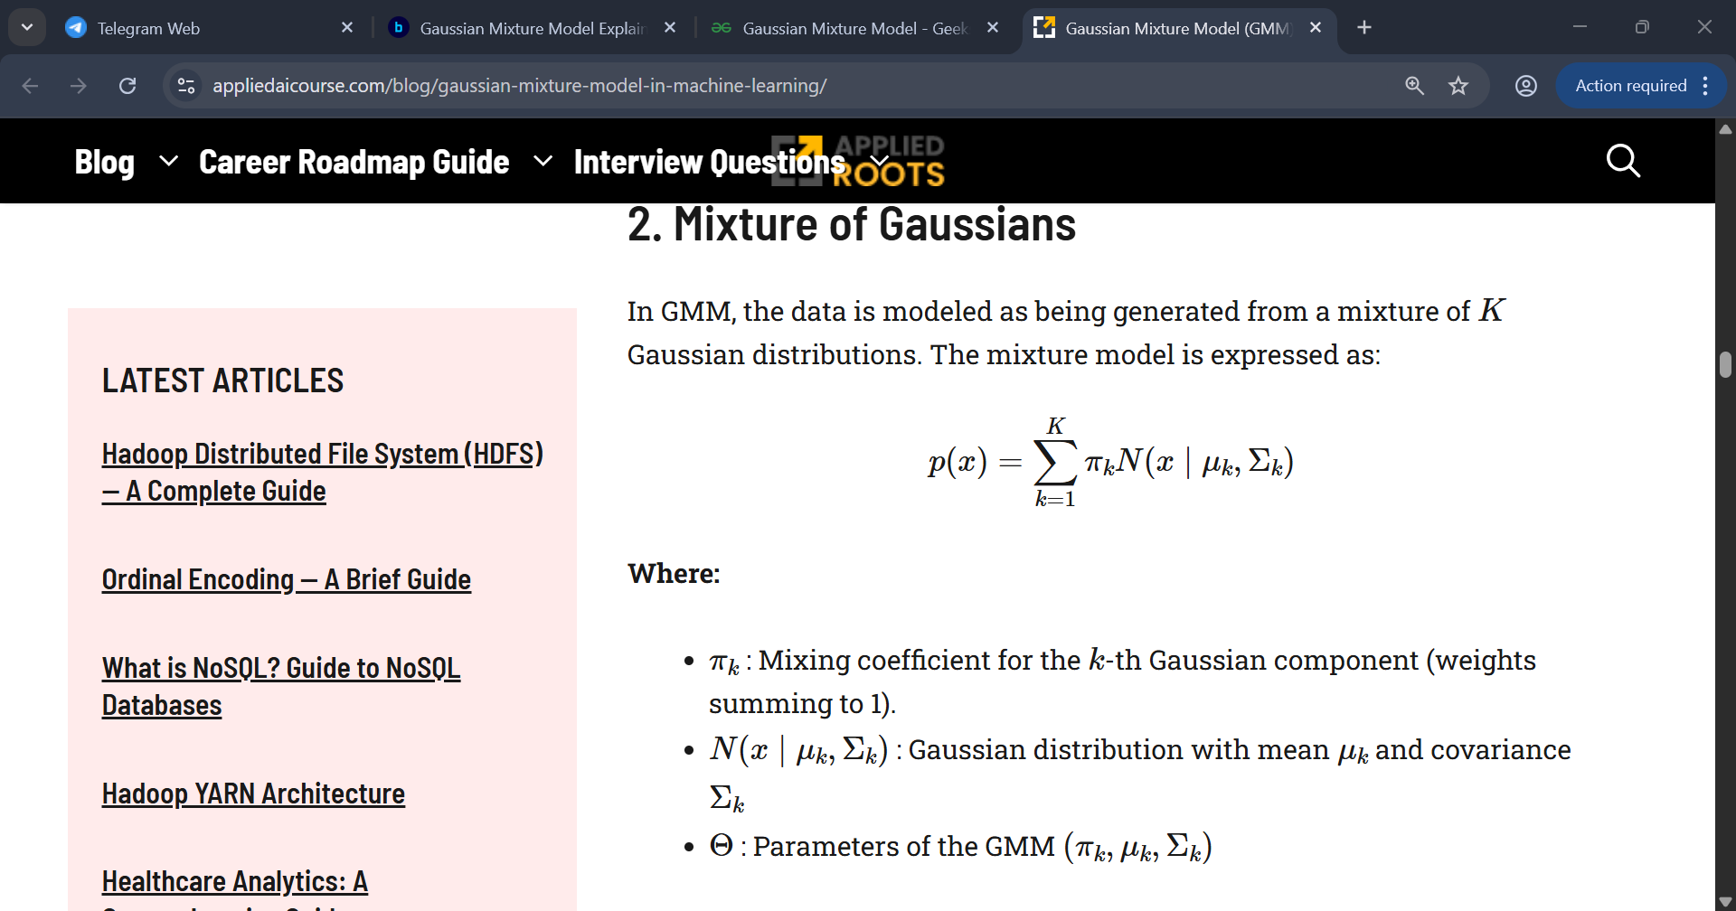

Slide 6
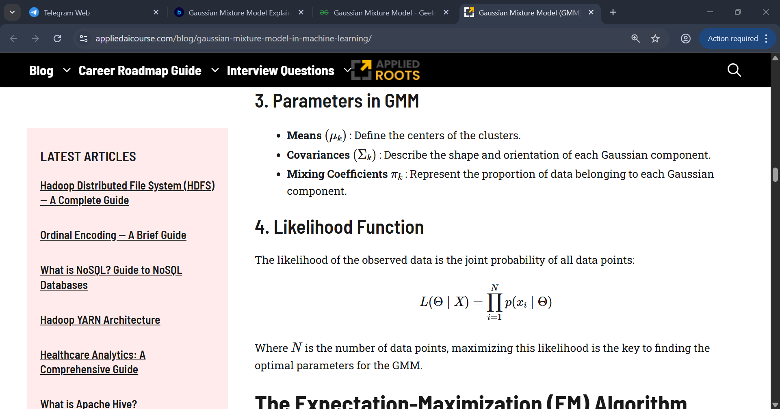

Slide 7
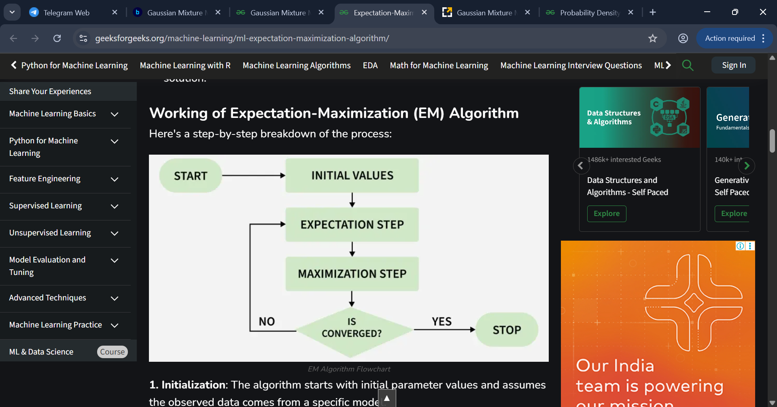
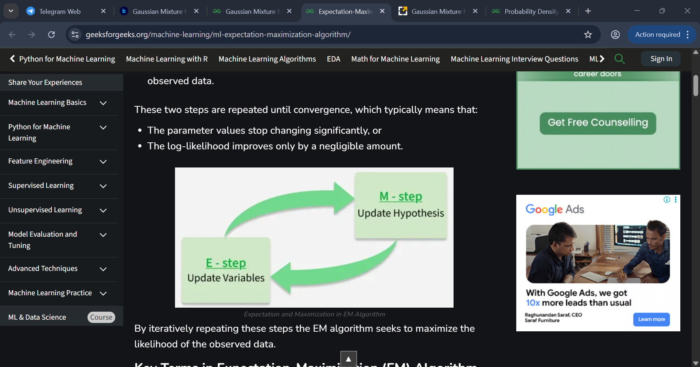

Slide 8
The Expectation-Maximization (EM) Algorithm
The Expectation-Maximization (EM) algorithm is the backbone of Gaussian Mixture Models, used for estimating the parameters of the Gaussian components. It iteratively refines these parameters to maximize the likelihood of the observed data.
Role of EM in GMM
EM finds the parameters of the Gaussian components by alternating between two steps
E-Step (Expectation): Assigns probabilities of each data point belonging to each Gaussian component.
M-Step (Maximization): Updates the parameters of the Gaussian components to maximize the likelihood.

Slide 9
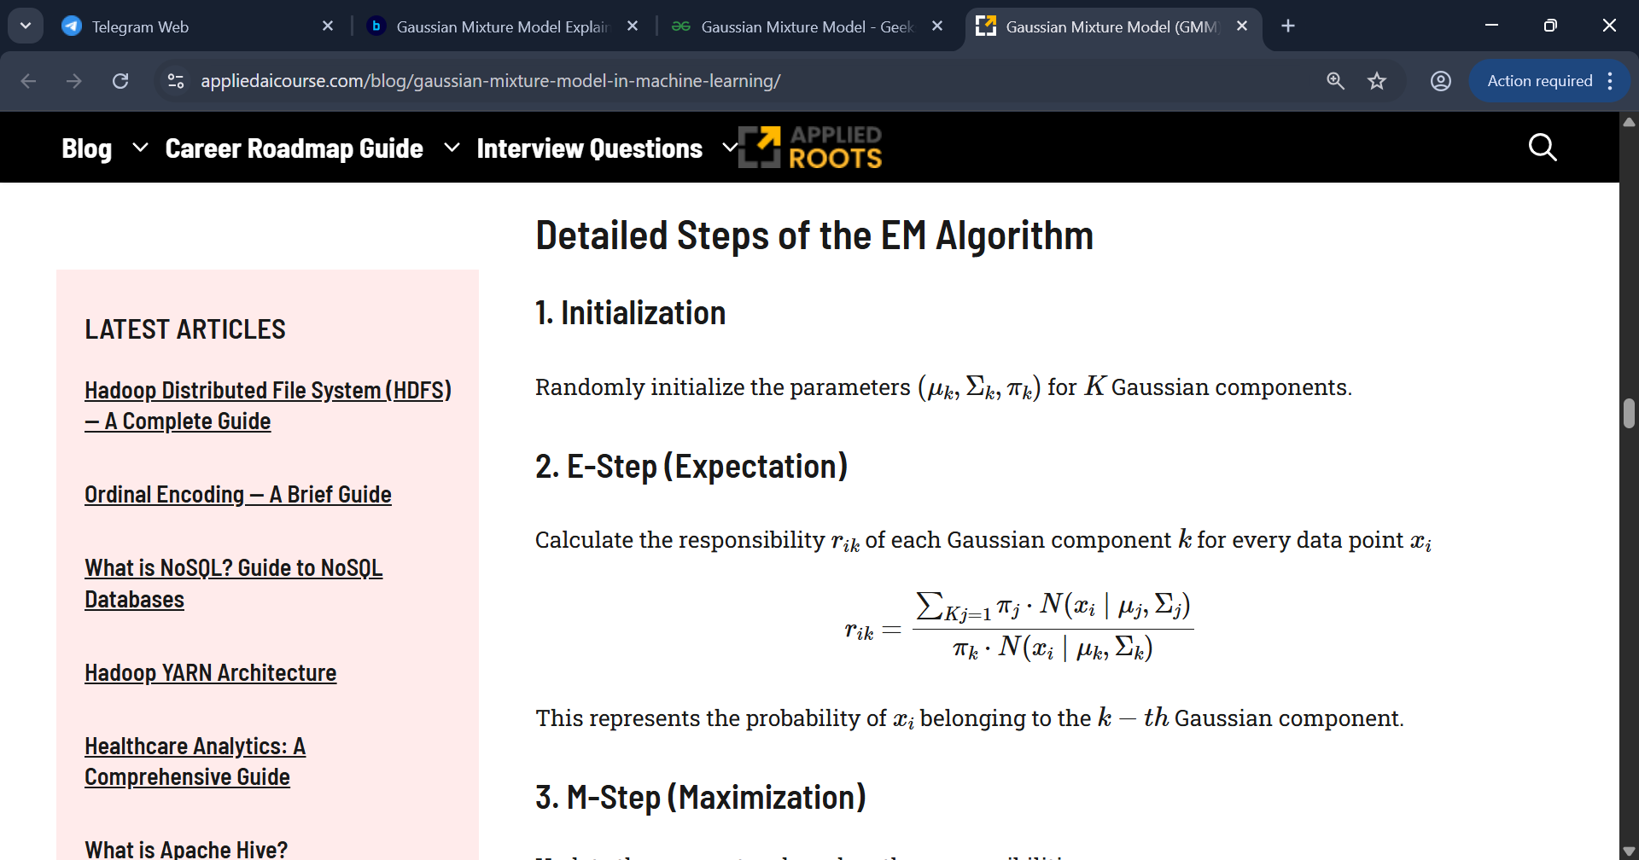
The Expectation-Maximization (EM) Algorithm
Detailed Steps of the EM Algorithm

Slide 10
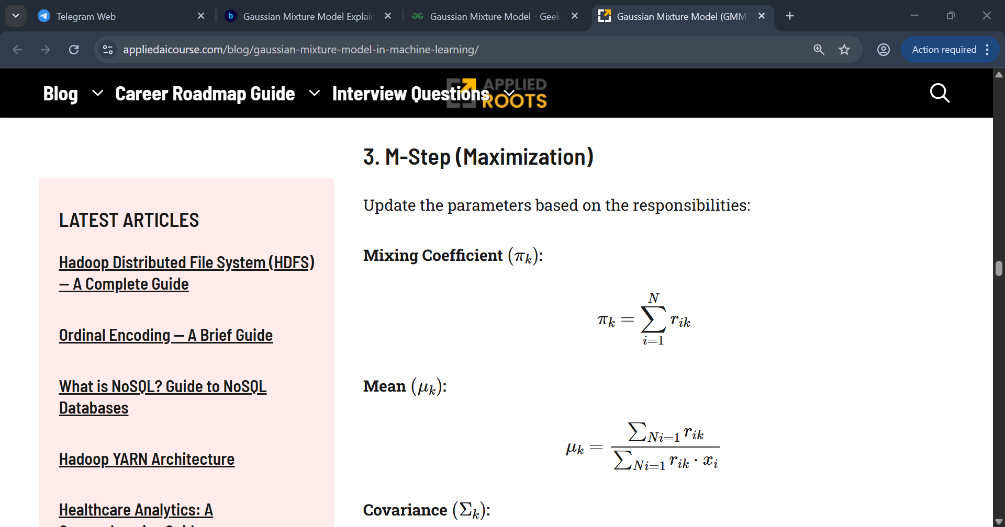
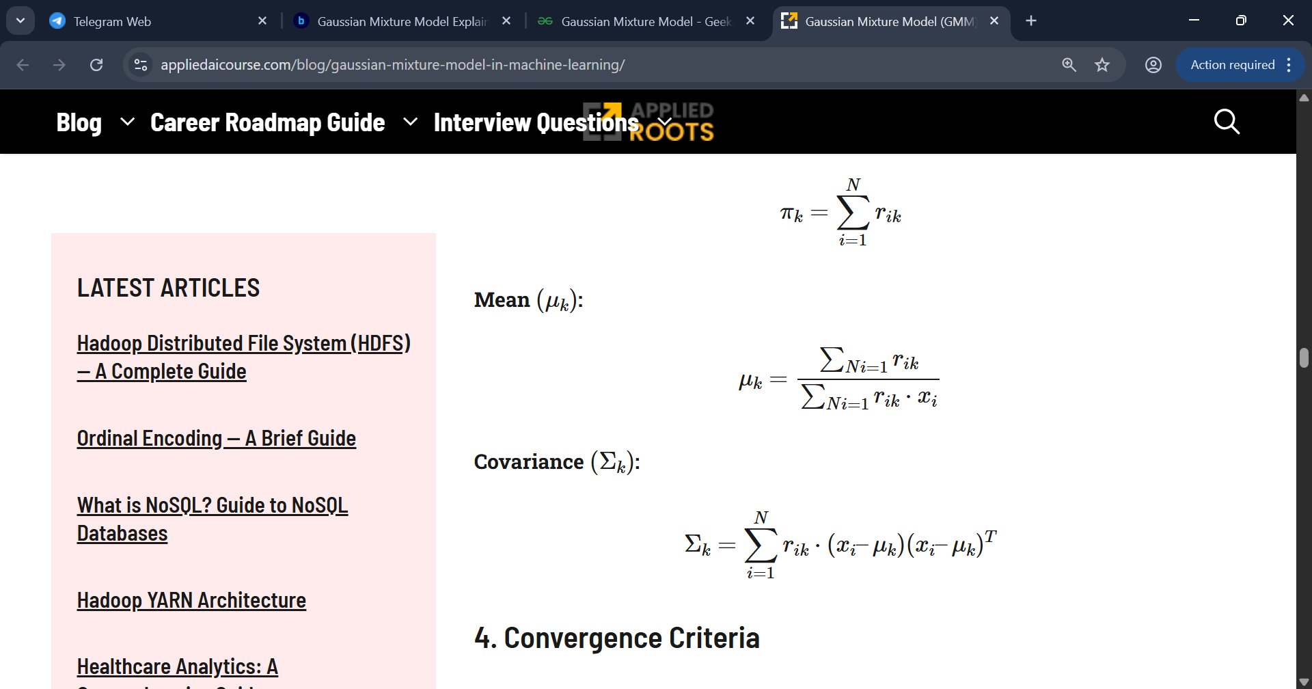
The Expectation-Maximization (EM) Algorithm

Slide 11
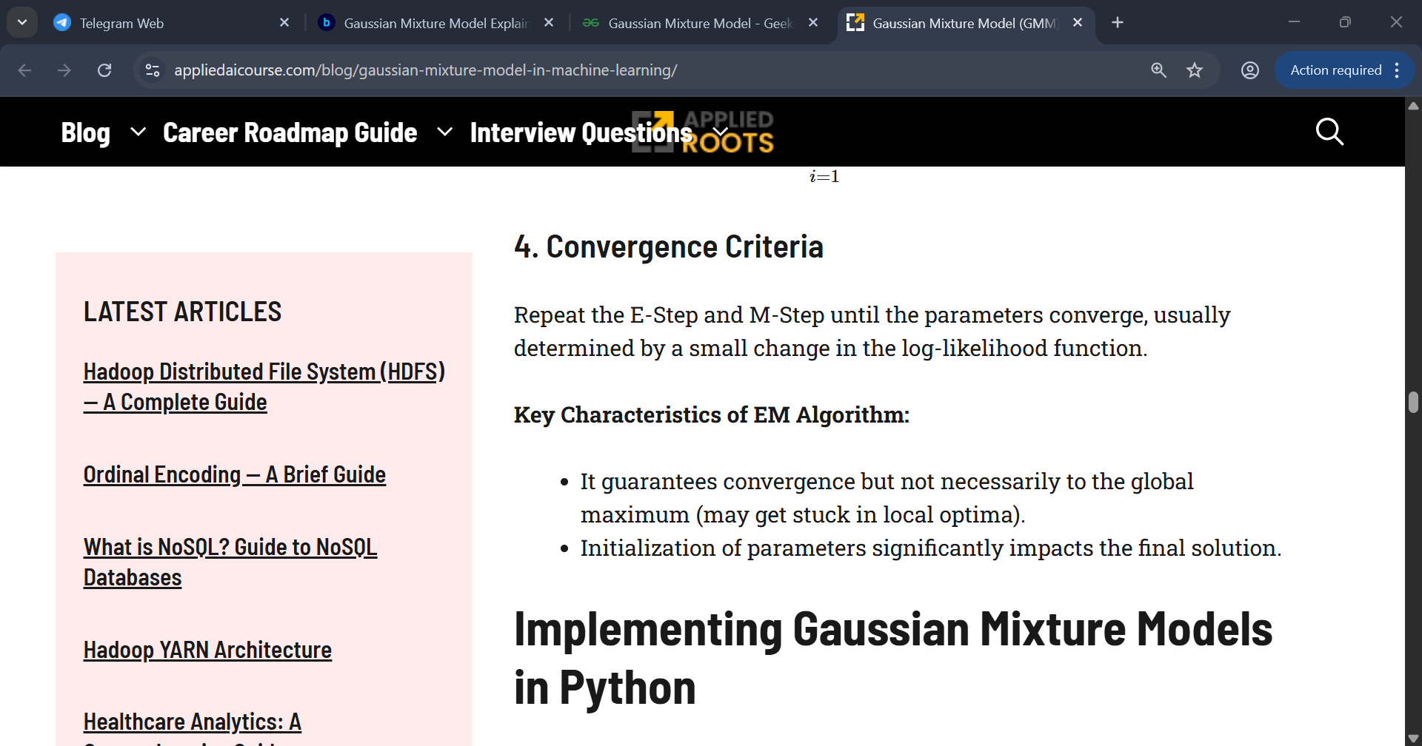

Slide 12
Density-Based Spatial Clustering of Applications with Noise [DBSCAN]
DBSCAN is a powerful clustering algorithm that groups points that are closely packed together in data space. Unlike some other clustering algorithms, DBSCAN doesn't require you to specify the number of clusters beforehand, making it particularly useful for exploratory data analysis.
The algorithm works by defining clusters as dense regions separated by regions of lower density. This approach allows DBSCAN to discover clusters of arbitrary shape and identify outliers as noise.

Slide 13
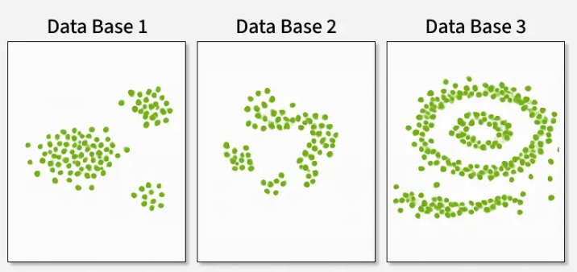
Unlike K-Means or hierarchical clustering which assumes clusters are compact and spherical, DBSCAN perform well in handling real-world data irregularities such as
Arbitrary-Shaped Clusters: Clusters can take any shape not just circular or convex.
Noise and Outliers: It effectively identifies and handles noise points without assigning them to any cluster.
K-Means and Hierarchical handling compact, spherical clusters with varying noise tolerance while DBSCAN manages arbitrary-shaped clusters and noise handling.

Slide 14
DBSCAN operates by examining the neighborhood of each point in the dataset. The algorithm follows a step-by-step process to identify clusters based on the density of data points. Let's break down how DBSCAN works --
Parameter Selection
Choose ε (epsilon): The maximum distance between two points for them to be considered as neighbors.
Choose MinPts: The minimum number of points required to form a dense region.
Select a Starting Point
The algorithm starts with an arbitrary unvisited point in the dataset.
Examine the Neighborhood
It retrieves all points within the ε distance of the starting point.
If the number of neighboring points is less than MinPts, the point is labeled as noise (for now).
If there are at least MinPts points within ε distance, the point is marked as a core point, and a new cluster is formed.

Slide 15
4. Expand the Cluster
All the neighbors of the core point are added to the cluster.
For each of these neighbors
If it's a core point, its neighbors are added to the cluster recursively.
If it's not a core point, it's marked as a border point, and the expansion stops.
5. Repeat the Process
The algorithm moves to the next unvisited point in the dataset.
Steps 3-4 are repeated until all points have been visited.
6. Finalize Clusters
After all points have been processed, the algorithm identifies all clusters.
Points initially labeled as noise might now be border points if they're within ε distance of a core point.
7. Handling Noise
Any points not belonging to any cluster remain classified as noise.

Slide 16
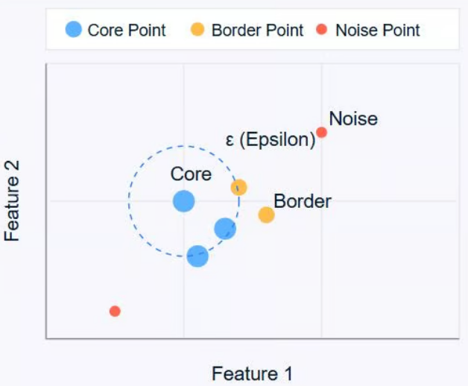
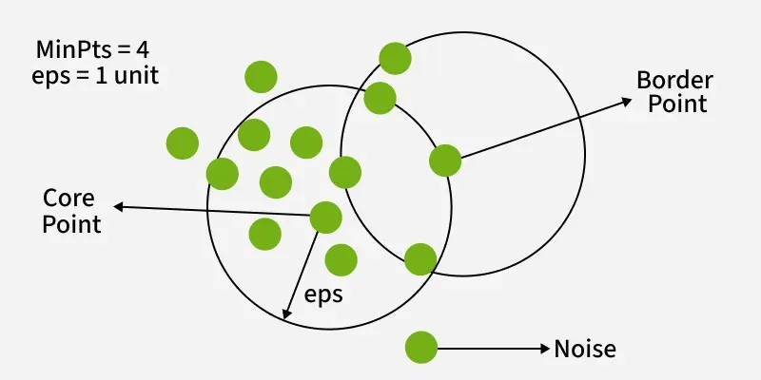
DBSCAN works by categorizing data points into three types--
Core Points: These are points that have at least a minimum number of other points (MinPts) within a specified distance (ε or epsilon). Core points have a sufficient number of neighbors within a specified radius (eplison)
Border Points: These are points that are within the ε distance of a core point but don't have MinPts neighbors themselves. Border points are near core points but lack enough neighbors to be core points themselves
Noise Points: These are points that are neither core points nor border points. They're not close enough to any cluster to be included.
By iteratively expanding clusters from core points and connecting density-reachable points, DBSCAN forms clusters without relying on rigid assumptions about their shape or size.
Core points form the heart of clusters, border points are on the edge of clusters, and noise points are isolated.

Slide 17
Mean-Shift Clustering
Meanshift is falling under the category of a clustering algorithm in contrast of Unsupervised learning that assigns the data points to the clusters iteratively by shifting points towards the mode (mode is the highest density of data points in the region, in the context of the Meanshift).
The algorithm does not require any prior information about the number of clusters present in the data, making it particularly useful for exploratory data analysis.
This makes it particularly useful for applications such as object recognition, where it can segment images based on pixel intensity and color, and also for tracking objects in video sequences.
As such, it is also known as the Mode-seeking algorithm. Mean-shift algorithm has applications in the field of image processing and computer vision.

Slide 18
As a mode-seeking algorithm, it labels the clusters by finding the modes, or peaks, in the data distribution. Essentially, it highlights the most dense areas. It does this by iteratively shifting the cluster centers toward regions of a higher data density. Here are the steps:
Initialization: Start by considering each data point as a potential candidate for the cluster center.
Density Estimation: For each data point, define a window around it, called the radius, and then compute the mean of those data points within this radius.
Shifting: Shift each point to this mean position. This step moves the point towards the region of higher density.
Convergence: Repeat steps 2 and 3 iteratively until convergence, i.e., when the shift is smaller than a predefined threshold. The insignificant change in shift implies that the points have stabilized around the local maxima of the density function.
At the end of this iterative process, data points cluster around the modes of the data distribution, forming the clusters. Mean shift is particularly flexible because it relies on the actual data distribution rather than assuming a predefined shape for clusters, which allows it to handle clusters of arbitrary shapes.

Slide 19
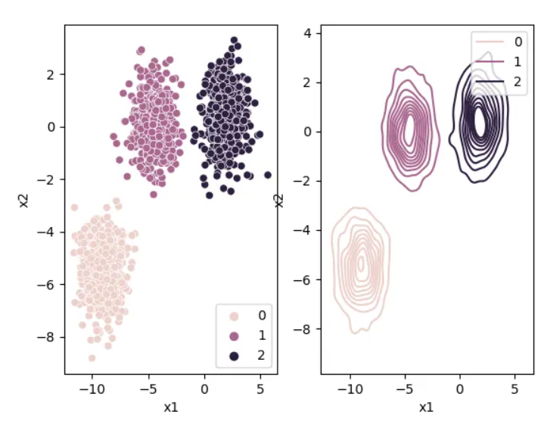
Working of Mean-Shift Algorithm
a) Kernel Density Estimation: The first step involves estimating the underlying probability density function (PDF) of the data points. This is typically done using kernel density estimation, where each data point is represented by a kernel function centered at that point. The kernel function specifies the weight assigned to each data point in the density estimation process.
Higher density regions correspond to regions with more data-points, and lower density regions correspond to regions with fewer points. Mean Shift tries to find the high-density regions by continually shifting the sliding window closer to the peak of the region. This is also known as hill climbing.

Slide 20
b) Shifting Data Points: In the second step, the algorithm iteratively shifts the data points towards regions of higher density. The shift is determined by calculating the mean shift vector for each data point, which represents the direction and magnitude of the shift. The mean shift vector is calculated as the weighted average of the differences between the data point and its neighboring points, where the weights are determined by the kernel function.
c) Convergence and Cluster Identification: The algorithm continues shifting the data points until convergence is reached. Convergence occurs when the mean shift vectors become very small or negligible. Once convergence is achieved, the final position of each data point represents a cluster center. The algorithm assigns each data point to the closest cluster center, thereby identifying the clusters within the data.

Slide 21
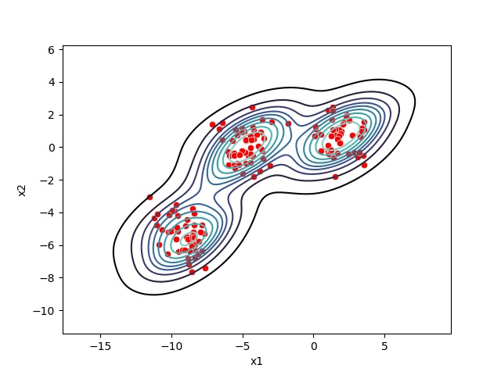
Mean-Shift Clustering
The Mean-Shift clustering algorithm is a density-based clustering algorithm, which means that it identifies clusters based on the density of the data points rather than the distance between them.
In other words, the algorithm identifies clusters based on the areas where the density of the data points is highest.

Slide 22
Cluster validity metrics
Cluster validity metrics are used to evaluate the quality of clusters formed by an algorithm, categorizing into internal metrics that use intrinsic data properties (like compactness and separation), external metrics that compare clusters to known ground truth labels, and relative metrics that compare results from different algorithm runs.
Common examples include the Silhouette coefficient, Davies-Bouldin index, and Dunn index for internal validation, while metrics like the Jaccard or Rand index are used for external validation

Slide 23
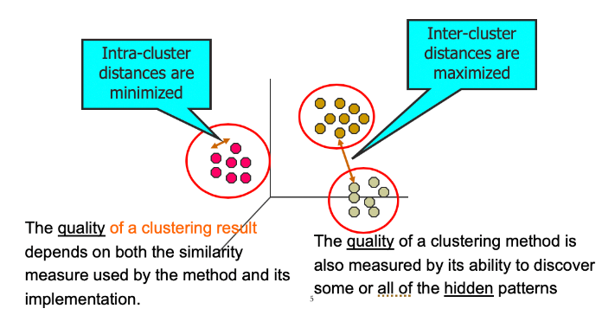

Slide 24
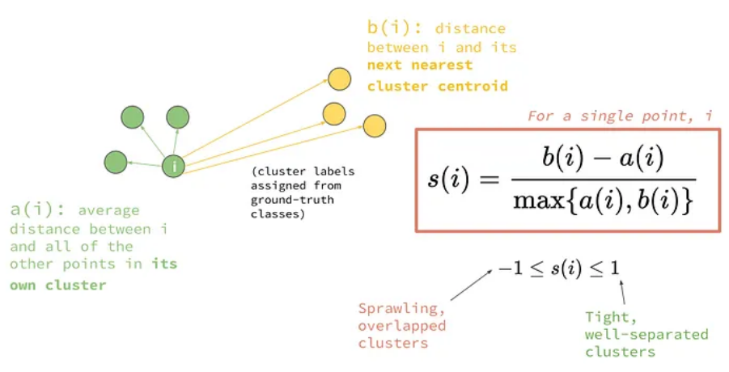
Internal validation metrics
These metrics assess cluster quality using only the data itself, focusing on compactness (how close points within a cluster are) and separation (how far apart different clusters are).
Silhouette Coefficient: Measures how well each data point is suited to its cluster, ranging from -1 to +1. A score near +1 means the point is well-clustered and far from other clusters; a score near 0 suggests it's on the boundary; and a negative score indicates it may be misclassified.

Slide 25
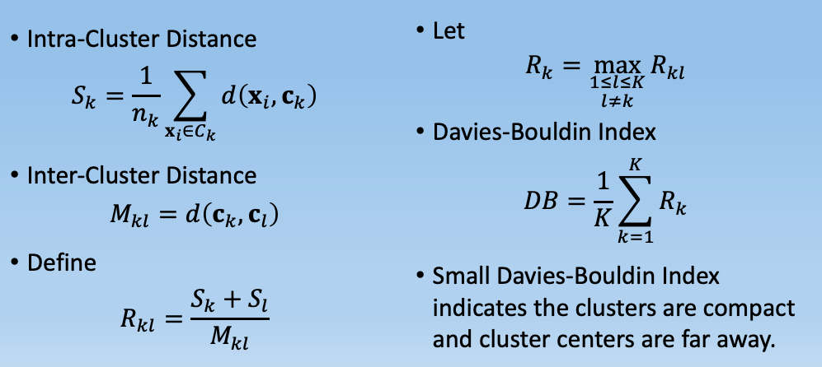
Davies-Bouldin Index: Calculates the average similarity ratio between each cluster and its most similar cluster. A lower score indicates better clustering, with tightly packed and well-separated clusters.

Slide 26
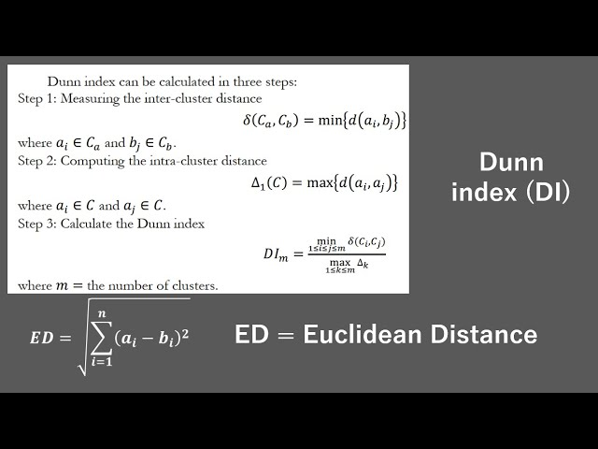
Dunn Index: A ratio of the minimum distance between clusters to the maximum distance of points within a cluster. A higher Dunn index signifies better-separated and more compact clusters.

Slide 27
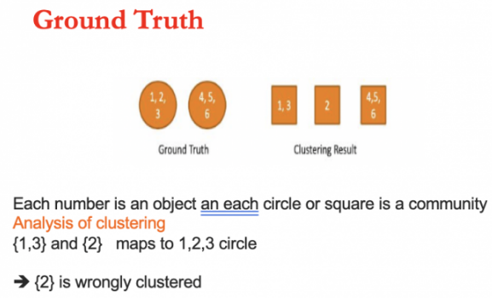
External validation metrics
These metrics are used when you have pre-existing labels (ground truth) for the data and compare the clustering results to them.

Slide 28
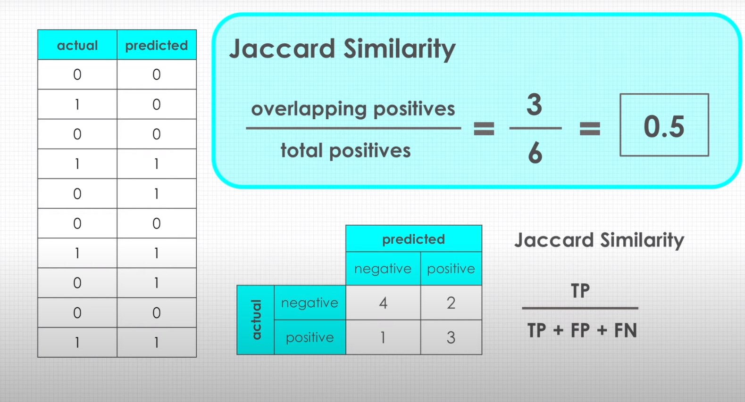
Jaccard Coefficient: Measures the similarity between the clustering result and the ground truth by comparing the ratio of intersections to unions of the clusters.

Slide 29
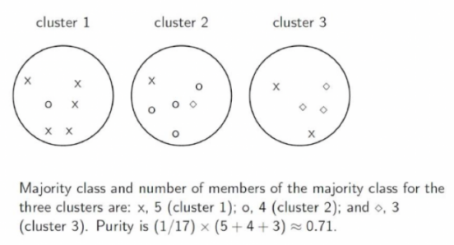
Purity: Measures the extent to which clusters match the true class labels.

Slide 30
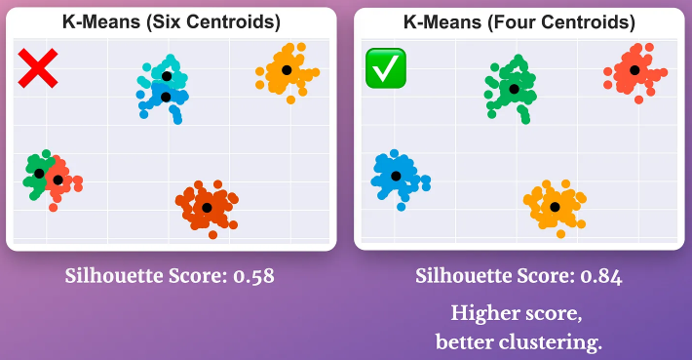
Relative validation metrics
These metrics are used to compare different clustering results obtained from running the same algorithm with different parameters.

